Slide 1
Titanic survival prediction
problem-based machine learning final project
隊名 : Machine learning 輕輕鬆鬆
組員 : 楊承燁(組長) 、陳佩昌、周易廷、陳彥溥

Slide 2
At 1912.4.10
Titanic take on her maiden voyage
but she never came back ...

Slide 3
Of the estimated 2,224 people, more than 1,500 died, making it one of modern history's deadliest peacetime commercial marine disasters ...

Slide 4
Not enough lifeboat?
Luck?
Love?
or some facts uncovered ...

Slide 5
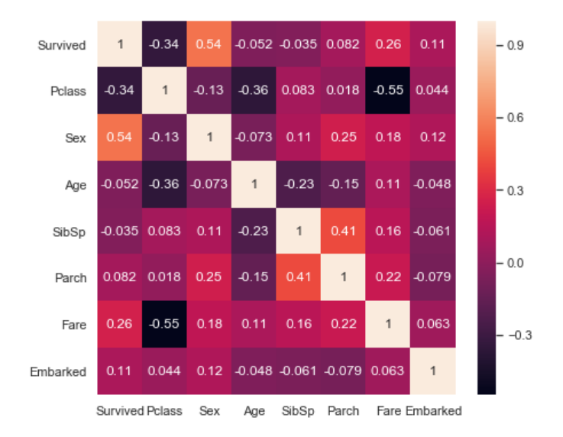
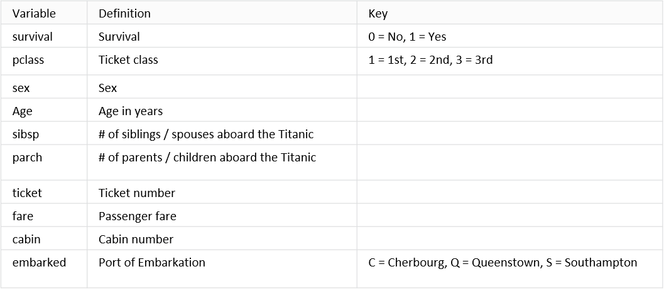
Data is what we got ...
result
factor
(features)

Slide 6
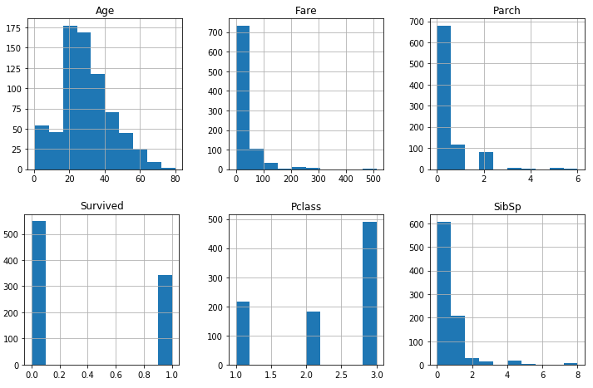
What’s the critical factor ?

Slide 7
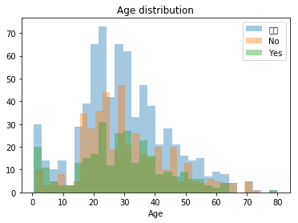
What’s the critical factor ?
age

Slide 8
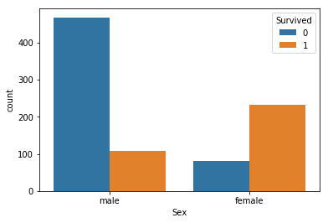
What’s the critical factor ?
age
Sex

Slide 9
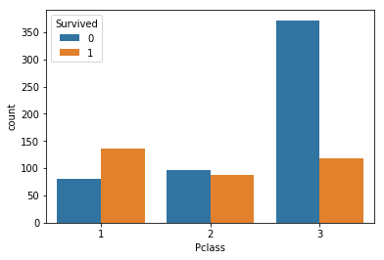
What’s the critical factor ?
age
Sex
PClass

Slide 10
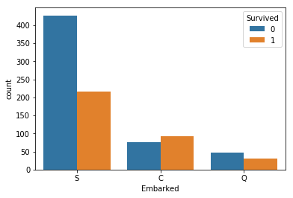
What’s the critical factor ?
age
Sex
PClass
Embarked

Slide 11
Data preprocessing
Filled nan data with Average/Median
Text mapping to value
Normalize data

Slide 12
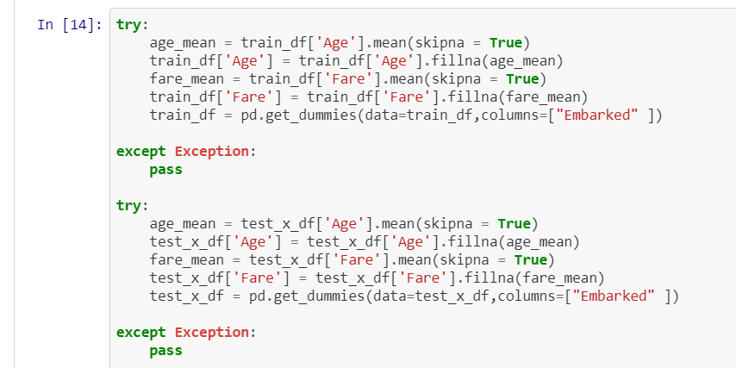
Drop nan and filled with Average

Slide 13
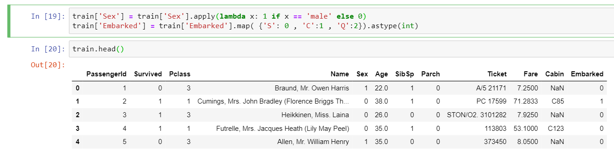
Mapping value

Slide 14
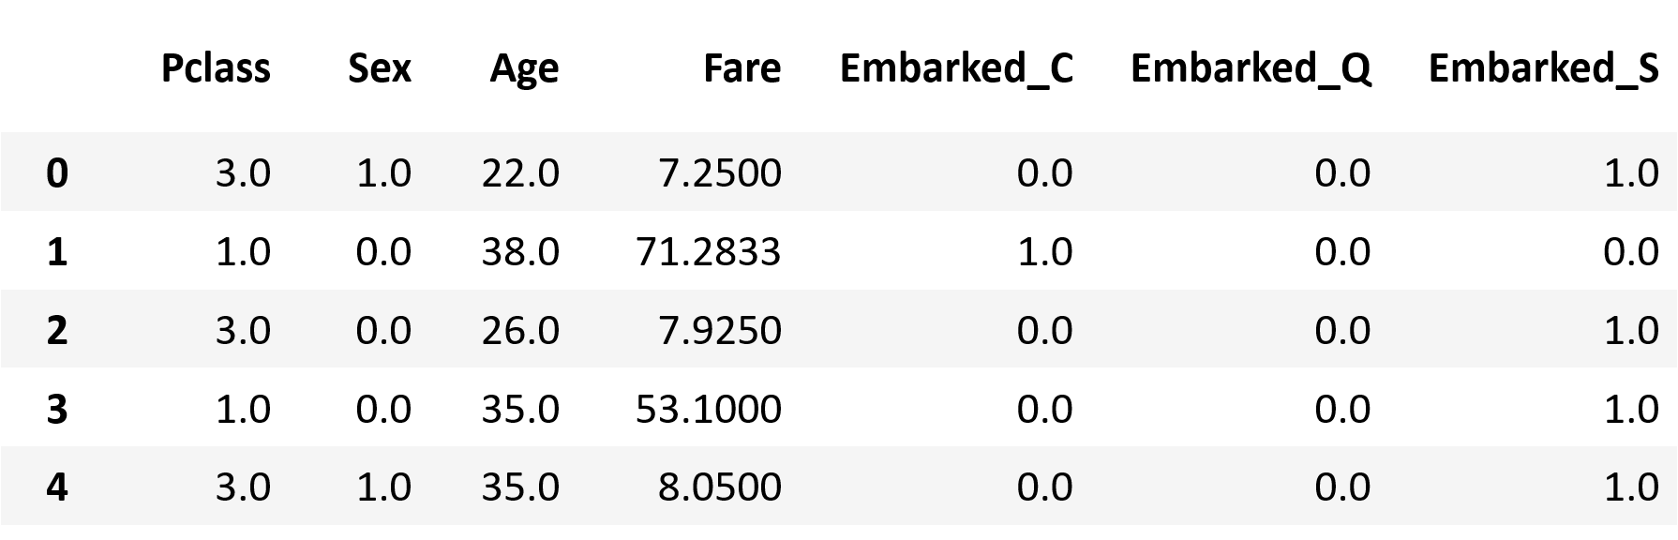
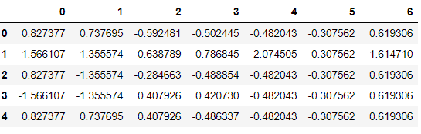
Normalize

Slide 15
Build the model
Logistic Regression
Decision tree
Deep neural network

Slide 16
Predicting Result
logistic regression, decision tree, D-NN

Slide 17
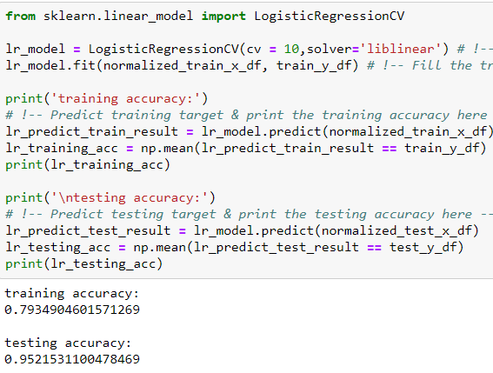
Logistic Regression
https://github.com/NekoSaiKou/NCKU_Problem_based_Machine-Learning/blob/master/Final/Titanic_regression.ipynb

Slide 18
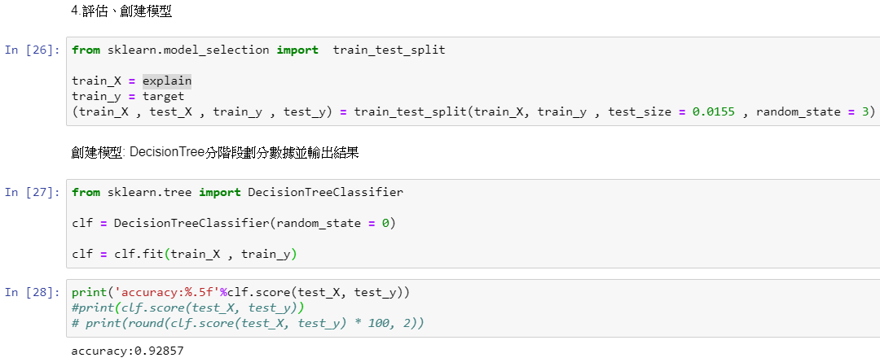
Decision tree
https://github.com/jhoutjyt/Final/blob/master/Final/Titanic-DecisionTree.ipynb

Slide 19
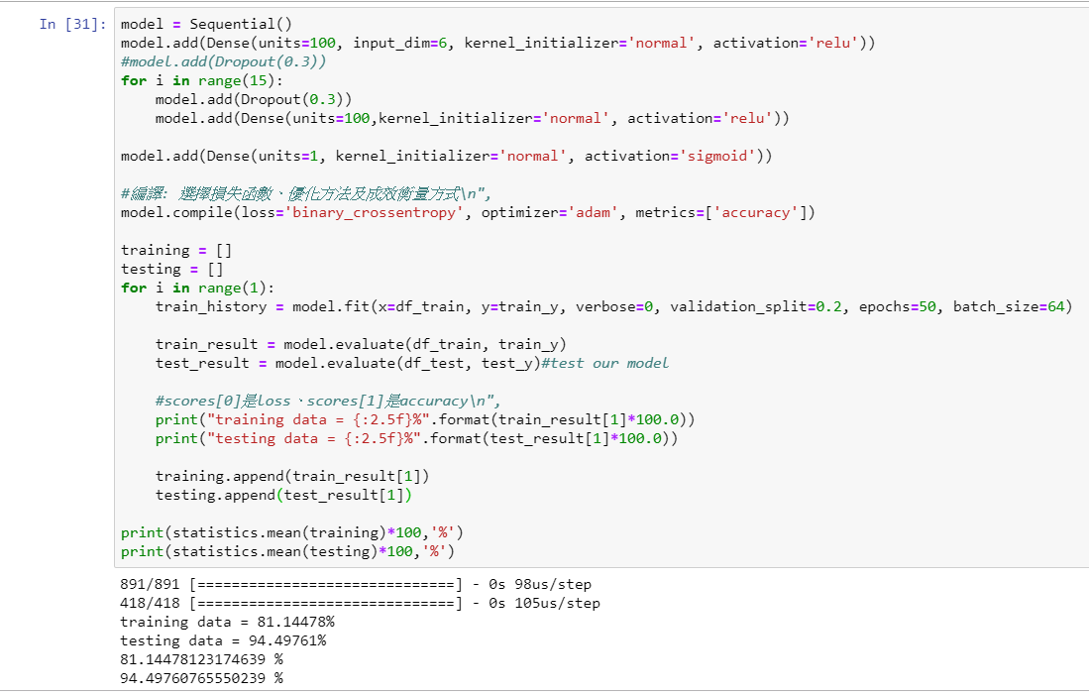
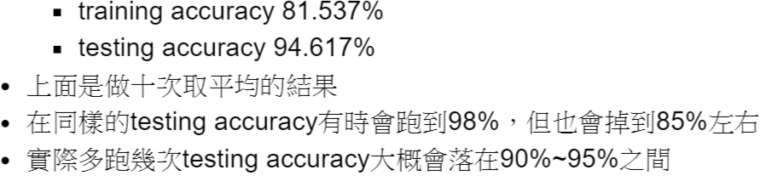
D-NN
https://github.com/csLesterChen/Problem-based-machine-learning/blob/master/final/Titanic_DNN.ipynb

Slide 20
The problem we faced so far ...

Slide 21
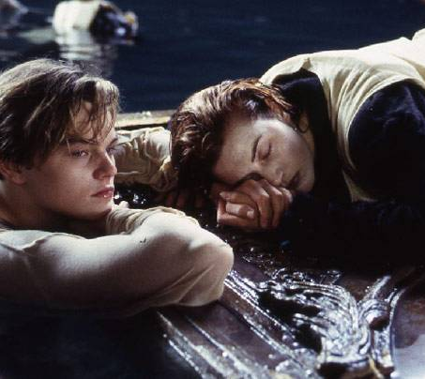
So can we predict the probability
that both Jack and Rose survive the ship wreck?

